Slide 1
Credit score classification
Internship-Spinnacker
Done by: Varsha V Nair

Slide 2
INTERNSHIP PROBLEM STATEMENT
Project Title: Credit Score Classification Description: Develop a robust machine learning model to accurately predict credit scores based on various financial and personal attributes. This model will automate the assessment of creditworthiness, enabling more efficient and data-driven decision-making in credit-related processes.

Slide 3
OVERVIEW
The project involves credit score classification where we deal with several features of the user and there by classifying the users credit score .
This involves data preprocessing ,feature engineering ,feature selection, data visualization and using various machine learning models and evaluating the models and there by taking the best model with best evaluation metrics

Slide 4
STEPS UNDERGONE
Importing libraries and Loading data
Overview of data
Data cleaning
EDA
FEATURE ENGINEERING
FEATURE SELECTION
DATA TRANSFORMATION
MODEL BUILDING AND EVALUATION
BEST MODEL SELECTION AND SAVING THE MODEL
DEPLOYMENT

Slide 5
IMPORTING LIBRARIES
In the starting phase of the project we need to import all the necessary libraries required for the project which are needed for data cleaning ,preprocessing ,visualization and model building .
The credit score classification project has two excel files : train.csv,test.csv
These are loaded and are used for further steps .

Slide 6
Loading and overview of data
The train dataset consists of 100000 users and 28 columns and test dataset has 50000 and 27 columns .now the dataset info,head,statistical describe ,missing values ,datatypes are checked
The features include :'ID', 'Customer_ID', 'Month', 'Name', 'Age', 'SSN', 'Occupation', 'Annual_Income', 'Monthly_Inhand_Salary', 'Num_Bank_Accounts', 'Num_Credit_Card', 'Interest_Rate', 'Num_of_Loan', 'Type_of_Loan', 'Delay_from_due_date', 'Num_of_Delayed_Payment', 'Changed_Credit_Limit', 'Num_Credit_Inquiries', 'Credit_Mix', 'Outstanding_Debt', 'Credit_Utilization_Ratio', 'Credit_History_Age', 'Payment_of_Min_Amount', 'Total_EMI_per_month', 'Amount_invested_monthly', 'Payment_Behaviour', 'Monthly_Balance', 'Credit_Score'
Then the two datasets are concated together for further steps

Slide 7
Data preprocessing
1. Data Inspection
Print value counts for categorical columns using a loop:
Display column names, separators, and their unique values.
2. Text Cleaning
Remove unwanted characters (e.g., _ ,") and handle invalid entries ('', 'nan', '!@9#%8').
Replace them with NaN.
3. Data Type Conversion
Convert columns to appropriate data types:
Hexadecimal to Integer: ID, Customer_ID.
String to Date: Month converted to numerical representation.
String to Integer/Float: For columns like Age, SSN, Annual_Income, etc.

Slide 8
Steps done on cleaning
4. Credit History Age Transformation
Custom function Month_Converter to convert "years and months" format into total months.
5. Grouping and Aggregation
Group Customer_ID by:
Credit_History_Age as a list.
Count and list unique Type_of_Loan.
6. Extract Unique Values
Function get_Diff_Values_Colum:
Extract and clean unique values from delimited columns like Type_of_Loan.
Key Outputs
Top 20 most frequent loans using value_counts.
Aggregated insights using groupby.

Slide 9
STEPS DONE ONData cleaning
Handling Missing Data and Data Standardization
Identify Missing Values
Analyze columns like "Name," "Occupation," "Credit Mix," and "Payment Behavior" for missing or invalid entries.
Fill Missing Data
Replace missing values with the most common (popular) entries for each customer group.
Standardize Data
Ensure consistency by replacing invalid values and grouping similar entries.
Summary Insights
Analyze loan types, payment patterns, and other customer behaviors for better insights.

Slide 10
STEPS DONE IN DATA CLEANING
Detect and Manage Outliers
Identify extreme values using statistical boundaries and adjust them within acceptable ranges.
Handle Missing Data
Replace missing entries with group-specific averages or most common values based on relevance.
Standardize and Validate
Ensure numerical and categorical fields are consistent, complete, and logically accurate for analysis.
Refine Insights
Address anomalies to improve data reliability for further modeling.

Slide 11
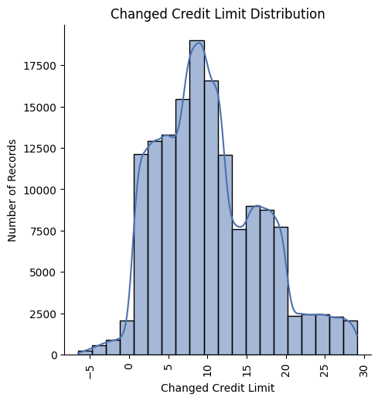
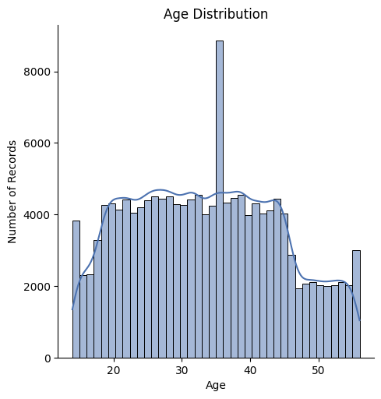
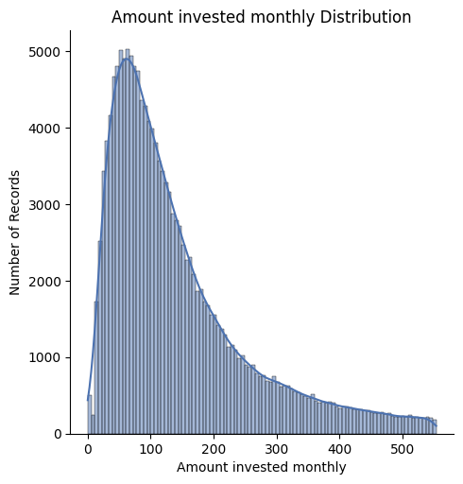
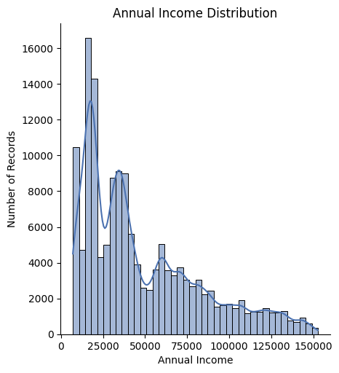
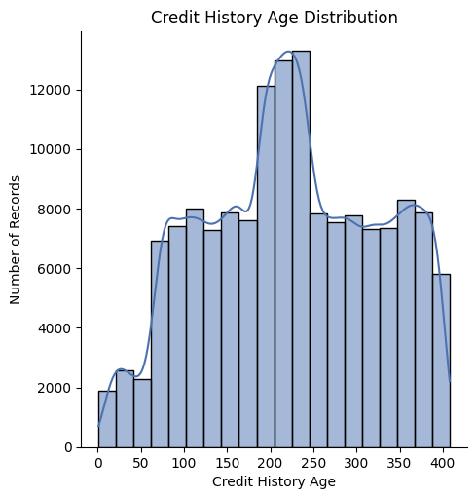
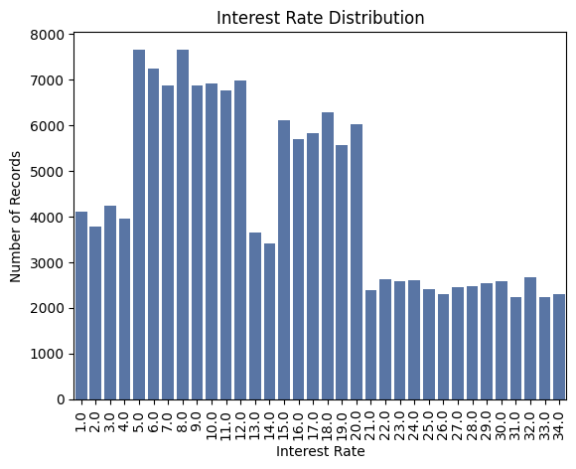
DATA VISUALIZATION

Slide 12
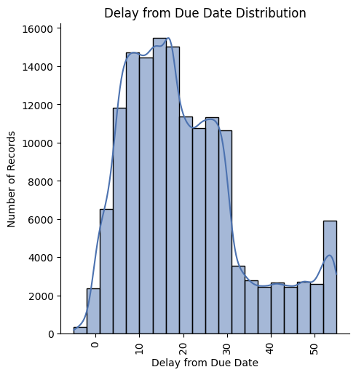
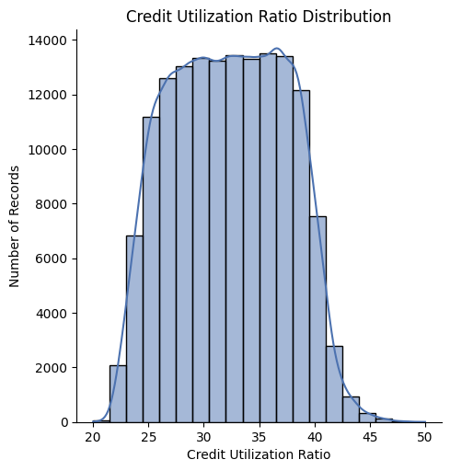
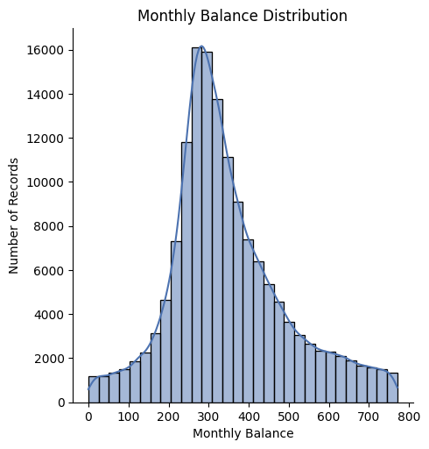
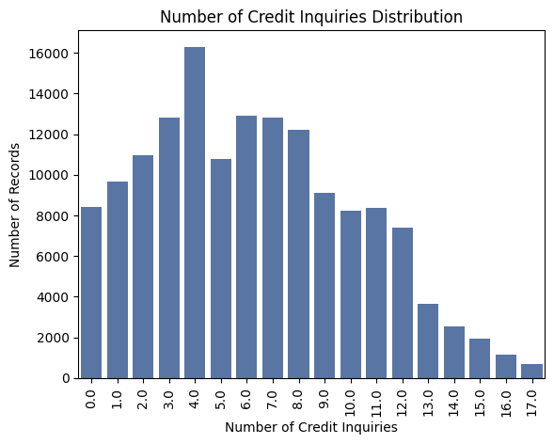
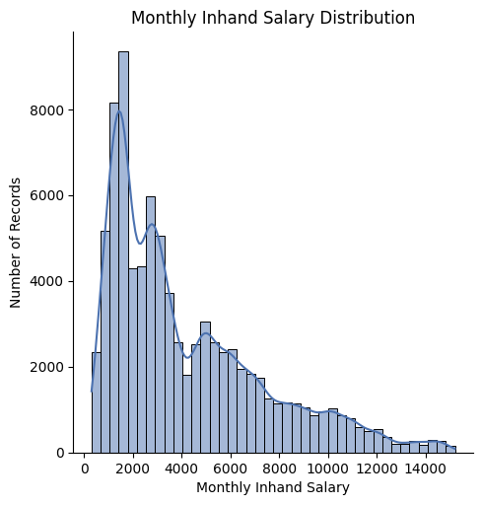
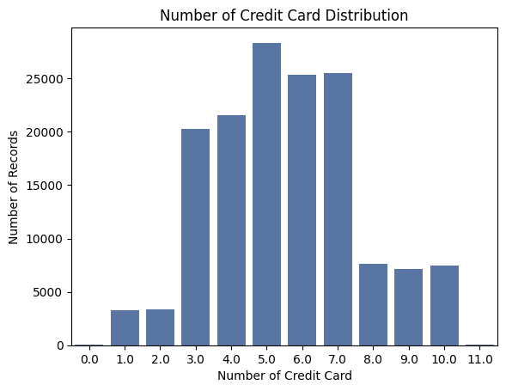
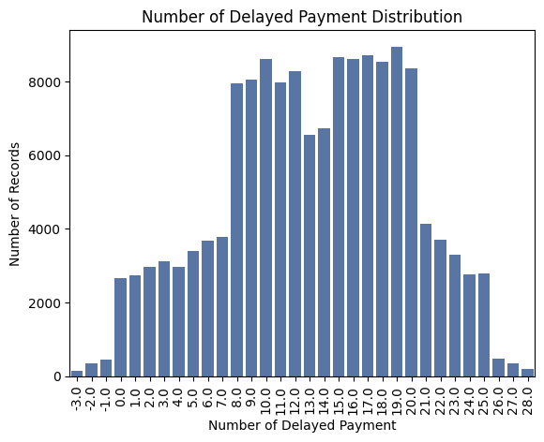
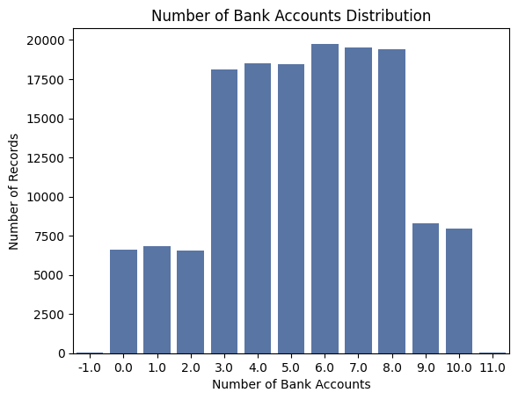
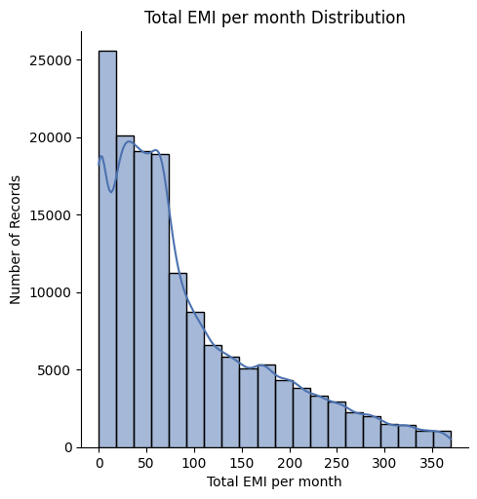
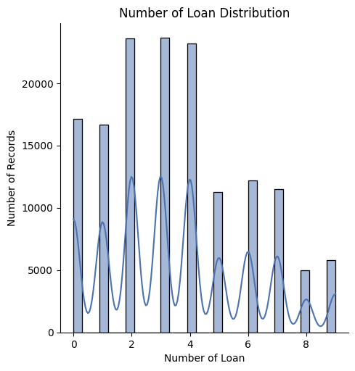

Slide 13
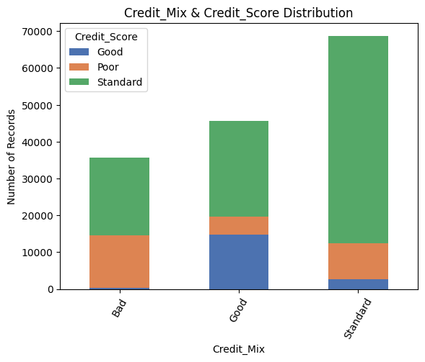
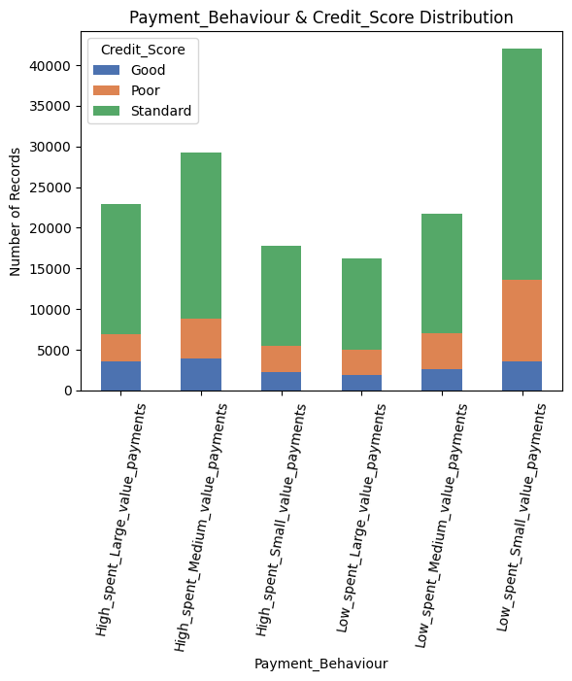
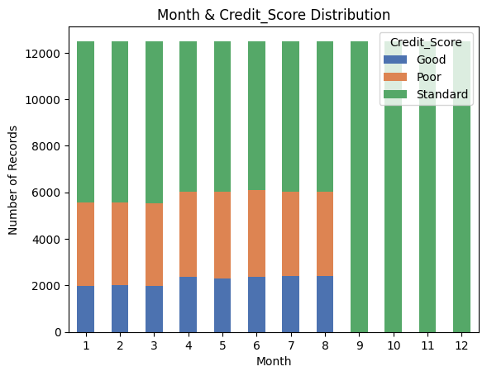

Slide 14
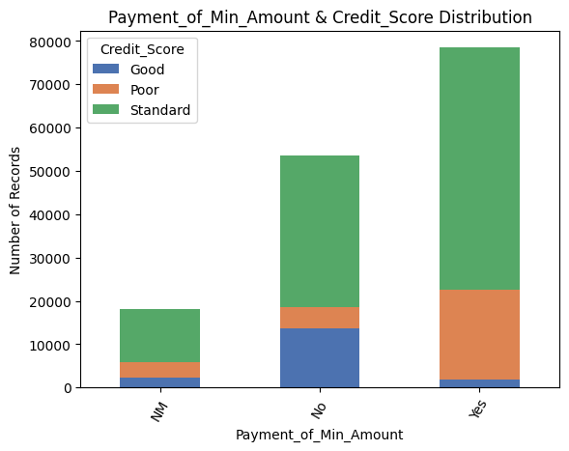
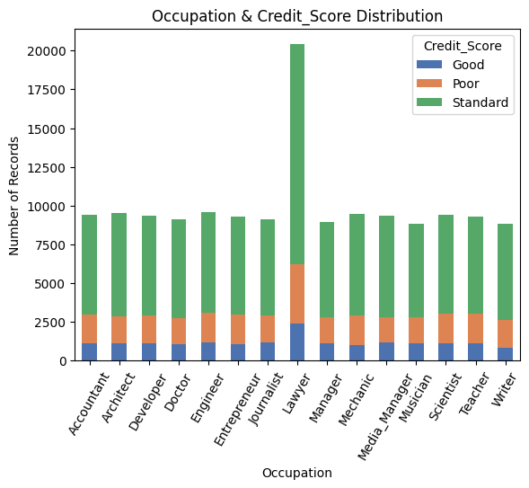
CREDIT SCORE

Slide 15
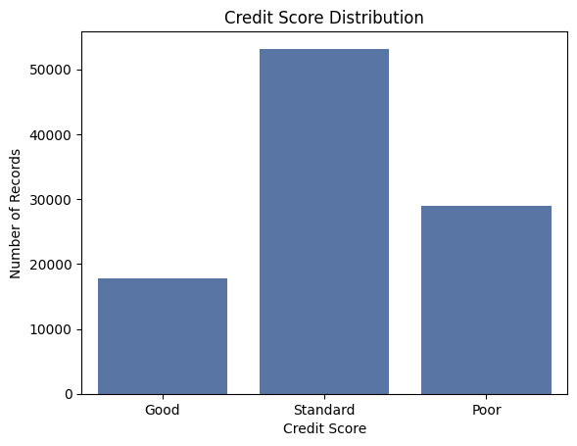
CREDIT SCORE

Slide 16
FEATURE CREATION
New features that are relevant for credit score:
Debt_to_Income_Ratio', 'Delayed_Payment_Ratio', 'Credit_Utilization_Efficiency‘ are created from the existing features .

Slide 17
Steps done in data preprocessing
Data Refinement and Outlier Adjustment
Identify Anomalies
Detect invalid or extreme values across numerical columns like accounts, delays, payments, balances, and investments.
Correct Outliers
Replace negative or unrealistic values with logical defaults, group-based averages, or remove them as needed.
Visualize Adjustments
Use box plots to validate the refinement process and ensure data consistency for analysis.
After this features like 'ID', 'Customer_ID', 'Name', 'SSN‘ are droped out .

Slide 18
FEATURE SELECTION
From the 28 feature those which are highly correlated with the credit score
For that correlation for numerical feature , chi square test and f test are used .
So from these methods.The features that are selected with the appropriate values are chosen :
'Credit_Mix', 'Num_of_Delayed_Payment', 'Changed_Credit_Limit',
'Payment_of_Min_Amount', 'Num_Bank_Accounts', 'Num_Credit_Inquiries',
'Delay_from_due_date', 'Interest_Rate', 'Credit_History_Age',
'Outstanding_Debt', 'Credit_Utilization_Efficiency', 'Type_of_Loan',
'Payment_Behaviour', 'Credit_Score

Slide 19
Data transformation
This incude:
Handling of imbalance of target: This include balancing the target variable credit score – poor,standard,good in same balance of value .
Label encoding : converts the categorical features to numerical so that models can use them
Normalization: min max scalar used to normalizing the data .

Slide 20
Model building
The data is split into train and test in 80%-20% form .
Now this is being used in various classification machine learning model like :KNN, Gaussion NB, "Logistic Regression" "Decision Tree“,"Random Forest, "Gradient Boosting“, "XGBoost“,"AdaBoost“.
After the model is trained they are evaluated using various metrics such as accuracy,precision recall,f1score.

Slide 21
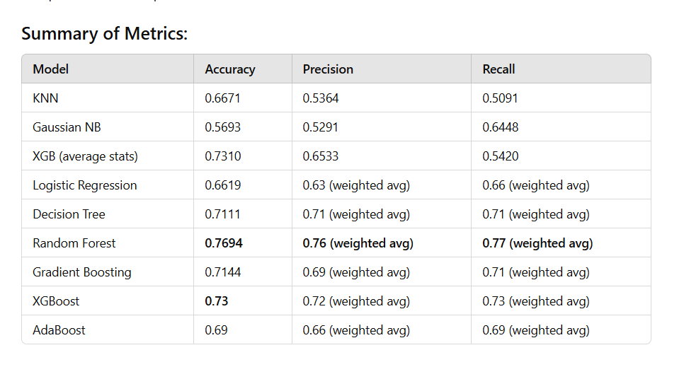
Model evaluation

Slide 22
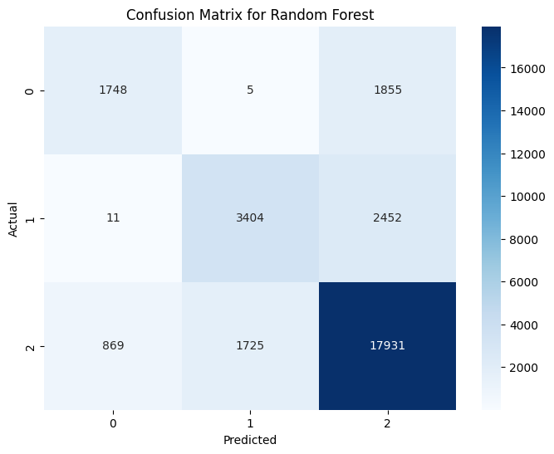
Best model
From the evaluation the best model was found out to be “random forest” which is saved for further .

Slide 23
Saving model
The best model is saved for further deployment by joblib ,pickle in the form –random_forest_model.pkl
Now this model is further used for deployment

Slide 24
Deployment
After the model is saved then the next step is to deploy it as web app
I have used streamlit for the deployment of as web app with the saved model.

Slide 25

Web app

Slide 26
THANK YOU

